Slide 1

Team A Hasanova Firuze & Karimova Zakhra
Unicode

Slide 2
UNICODE
Unicode is a universal character set, ie. a standard that defines, in one place, all the characters needed for writing the majority of living languages in use on computers. It aims to be, and to a large extent already is, a superset of all other character sets that have been encoded.
Text in a computer or on the Web is composed of characters. Characters represent letters of the alphabet, punctuation, or other symbols.
In the past, different organizations have assembled different sets of characters and created encodings for them – one set may cover just Latin-based Western European languages (excluding EU countries such as Bulgaria or Greece), another may cover a particular Far Eastern language (such as Japanese), others may be one of many sets devised in a rather ad hoc way for representing another language somewhere in the world.
Unfortunately, you can’t guarantee that your application will support all encodings, nor that a given encoding will support all your needs for representing a given language. In addition, it is usually impossible to combine different encodings on the same Web page or in a database, so it is usually very difficult to support multilingual pages using ‘legacy’ approaches to encoding.

Slide 3
The Unicode Consortium provides a large, single character set that aims to include all the characters needed for any writing system in the world, including ancient scripts (such as Cuneiform, Gothic and Egyptian Hieroglyphs). It is now fundamental to the architecture of the Web and operating systems, and is supported by all major web browsers and applications. The Unicode Standard also describes properties and algorithms for working with characters.

Slide 4
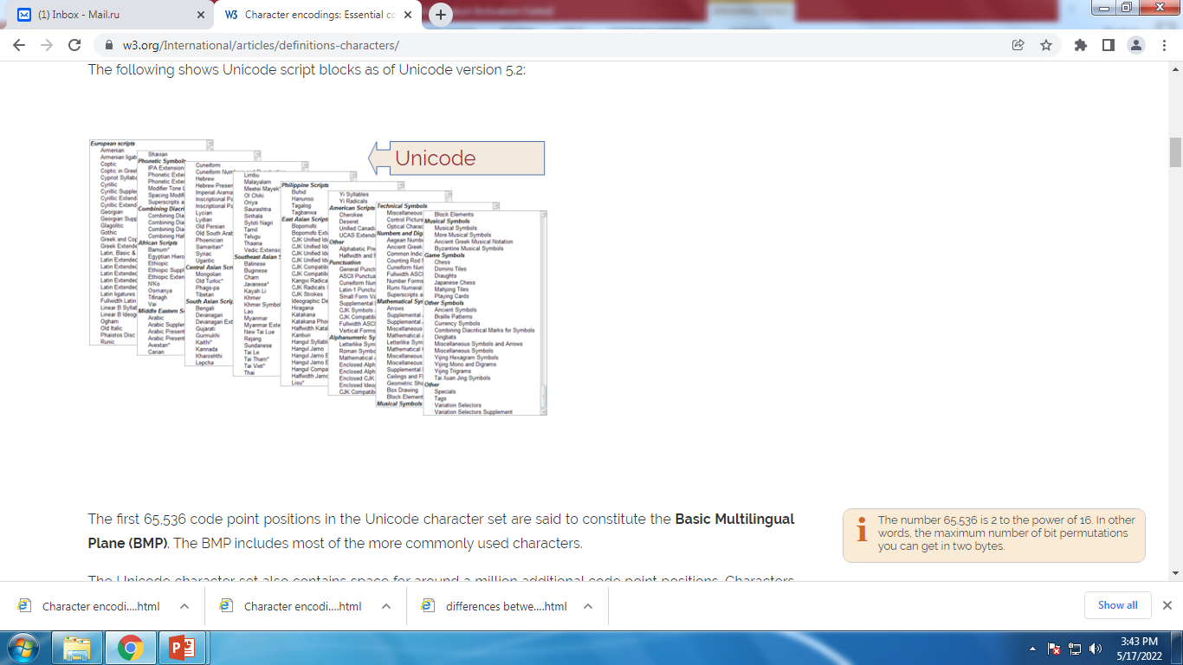

Slide 5
The first 65,536 code point positions in the Unicode character set are said to constitute the Basic Multilingual Plane (BMP). The BMP includes most of the more commonly used characters.
The number 65,536 is 2 to the power of 16. In other words, the maximum number of bit permutations you can get in two bytes.
The Unicode character set also contains space for around a million additional code point positions. Characters in this latter range are referred to as supplementary characters.

Slide 6
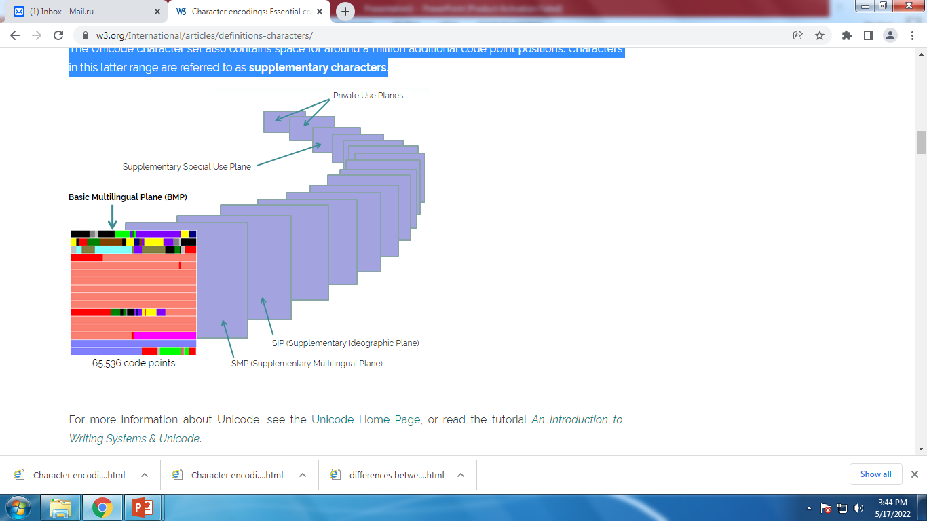

Slide 7
CHARACTER SETS, CODED CHARACTER SETS, AND ENCODINGS
It is important to clearly distinguish between the concepts of a character set versus a character encoding.
A character set or repertoire comprises the set of characters one might use for a particular purpose – be it those required to support Western European languages in computers, or those a Chinese child will learn at school in the third grade (nothing to do with computers).
A coded character set is a set of characters for which a unique number has been assigned to each character. Units of a coded character set are known as code points. A code point value represents the position of a character in the coded character set. For example, the code point for the letter á in the Unicode coded character set is 225 in decimal, or 0xE1 in hexadecimal notation. (Note that hexadecimal notation is commonly used for referring to code points, and will be used here.) A Unicode code point can have a value between 0x0000 and 0x10FFFF.
Coded character sets are sometimes called code pages.
The character encoding reflects the way the coded character set is mapped to bytes for manipulation in a computer. The picture below shows how characters and code points in the Tifinagh (Berber) script are mapped to sequences of bytes in memory using the UTF-8 encoding (which we describe in this section). The code point values for each character are listed immediately below the glyph (ie. the visual representation) for that character at the top of the diagram. The arrows show how those are mapped to sequences of bytes, where each byte is represented by a two-digit hexadecimal number. Note how the Tifinagh code points map to three bytes, but the exclamation mark maps to a single byte.

Slide 8
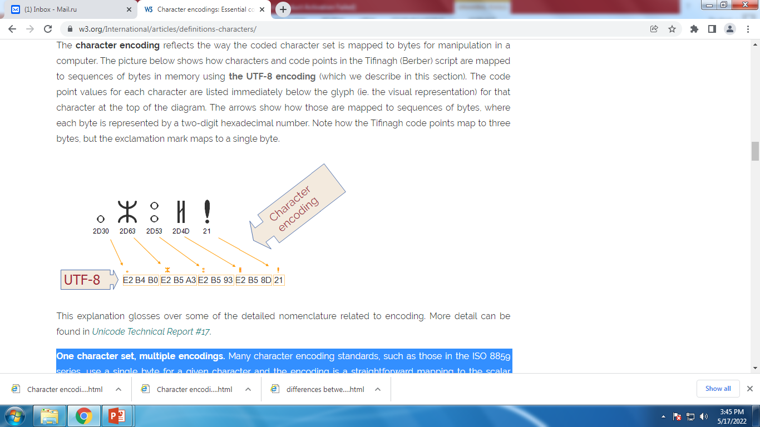

Slide 9
One character set, multiple encodings. Many character encoding standards, such as those in the ISO 8859 series, use a single byte for a given character and the encoding is a straightforward mapping to the scalar position of the characters in the coded character set. For example, the letter A in the ISO 8859-1 coded character set is in the 65th character position (starting from zero), and is encoded for representation in the computer using a byte with the value of 65. For ISO 8859-1 this never changes.
For Unicode, however, things are not so straightforward. Although the code point for the letter á in the Unicode coded character set is always 225 (in decimal), in UTF-8 it is represented in the computer by two bytes. In other words there isn't a trivial, one-to-one mapping between the coded character set value and the encoded value for this character.
In addition, in Unicode there are a number of ways of encoding the same character. For example, the letter á can be represented by two bytes in one encoding and four bytes in another. The encoding forms that can be used with Unicode are called UTF-8, UTF-16, and UTF-32.

Slide 10
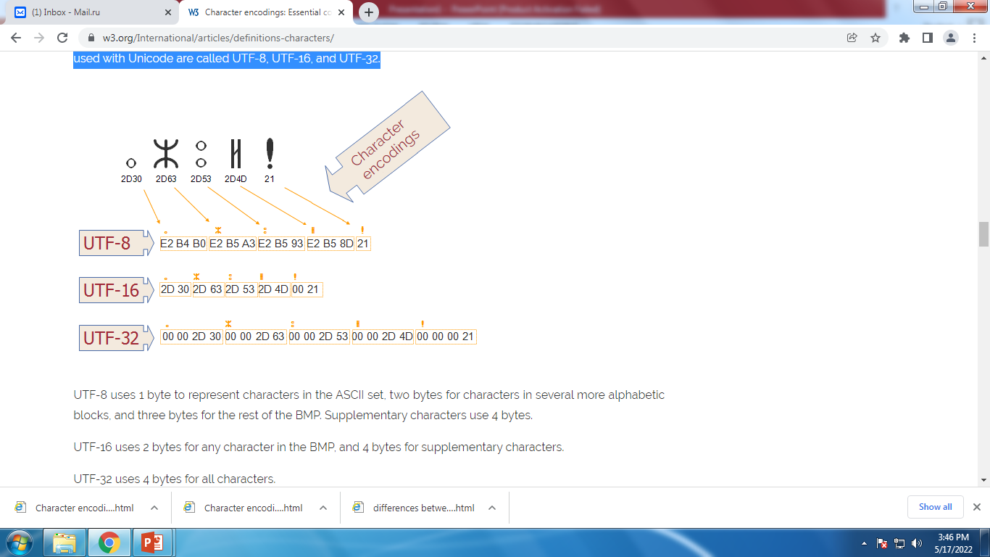

Slide 11
UTF-8 uses 1 byte to represent characters in the ASCII set, two bytes for characters in several more alphabetic blocks, and three bytes for the rest of the BMP. Supplementary characters use 4 bytes.
UTF-16 uses 2 bytes for any character in the BMP, and 4 bytes for supplementary characters.
UTF-32 uses 4 bytes for all characters.
In the following chart, the first line of numbers represents the position of a character in the Unicode coded character set. The other lines show the byte values used to represent that character in a particular character encoding.

Slide 12
Code point | U+0041 | U+05D0 | U+597D | U+233B4
UTF-8 | 41 | D7 90 | E5 A5 BD | F0 A3 8E B4
UTF-16 | 00 41 | 05 D0 | 59 7D | D8 4C DF B4
UTF-32 | 00 00 00 41 | 00 00 05 D0 | 00 00 59 7D | 00 02 33 B4

